Slide 1



Customer Relationship Management (CRM) System
KRISH SHINDE
150096725004
By Krish Shinde
Roll number - 150096725004

Slide 2

Index
Problem Statement
Our Solution
Working (Method / Mind Map)
Conclusion

Slide 3
Problem Statement
Businesses interact with many customers every day. Managing customer details and communication manually can be difficult and unorganized. Important information can be lost, and it becomes hard to track customer interactions.
Therefore, a simple system is needed to store customer details and keep track of interactions in an organized way.
The goal of this project is to develop a CRM system using C++ that allows users to add customer information, record interactions, and view stored data easily.

Slide 4
Our Solution
To solve this problem, we developed a simple CRM system using C++.
The system allows users to:
Add customer details
View customer records
Record interaction notes
View interaction history
The program uses classes and file handling to store data. It also uses a menu-driven interface so users can easily choose different options.

Slide 5
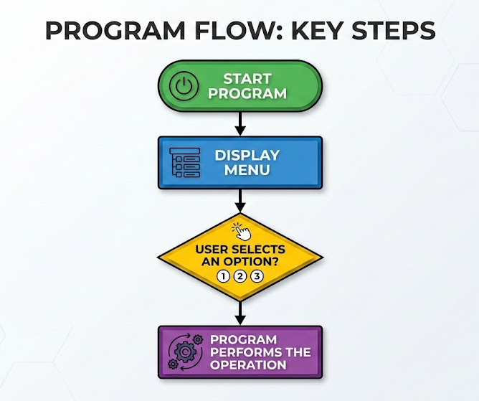
Working (Method / Mind Map)
Operations:
Add Customer → Save customer details in file
View Customers → Read and display customer data
Add Interaction → Save interaction note
View Interactions → Display interaction history
All data is stored using file handling in C++.

Slide 6
Conclusion
The CRM system was successfully developed using C++.
It allows users to:
Store customer details
Record customer interactions
View stored information easily
The system uses classes, file handling, and a menu-driven program to manage data.
This project shows how basic programming concepts can be used to build a simple and useful customer management system.

Slide 7


